Slide 1
Backup Slides

Slide 2
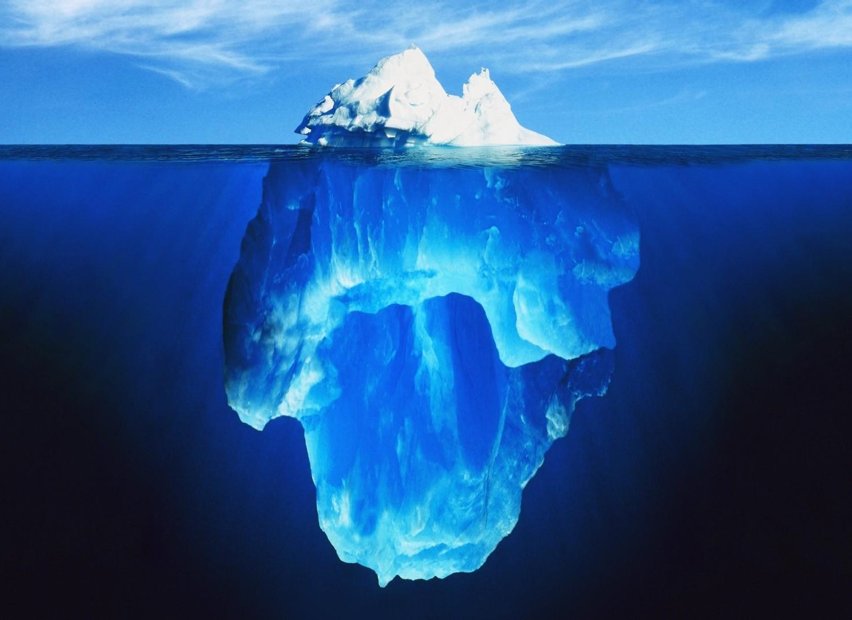

The Simplest Model of All
“Essentially, all models are wrong, but some are useful.”
- George E. P. Box (1919 – 2013)
Hall’s Iceberg Model of Culture
Taoist Yin Yang Model
Extravert vs Introvert
Behavior vs Belief
Individualism vs Collectivism
Adventurous vs Risk aversion
Software vs. Hardware
Applications vs. Infrastructure
Users vs. Systems
IT vs Business
Overt
Yang
Covert
Yin

Slide 3
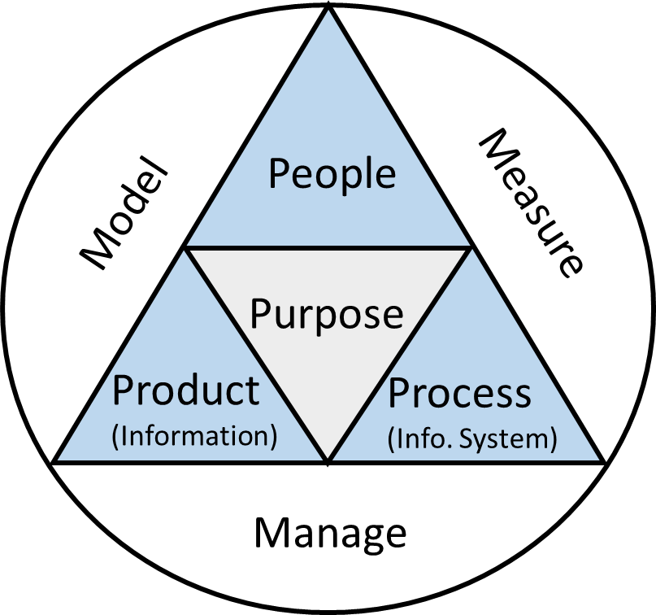
Wang’s Simple Model (4P3M)
An information system is a process that produces information to enable people to make better decisions faster;
People perform work activities, produce products, and provide services to customers;
An organization and its people ultimately work toward a common purpose
In order to improve efficiency and effectiveness, an organization needs to model, measure, and manage its business processes, activities, and performance.

Slide 4
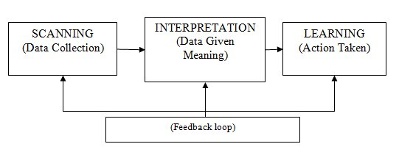
Organizational Learning Theory

Slide 5
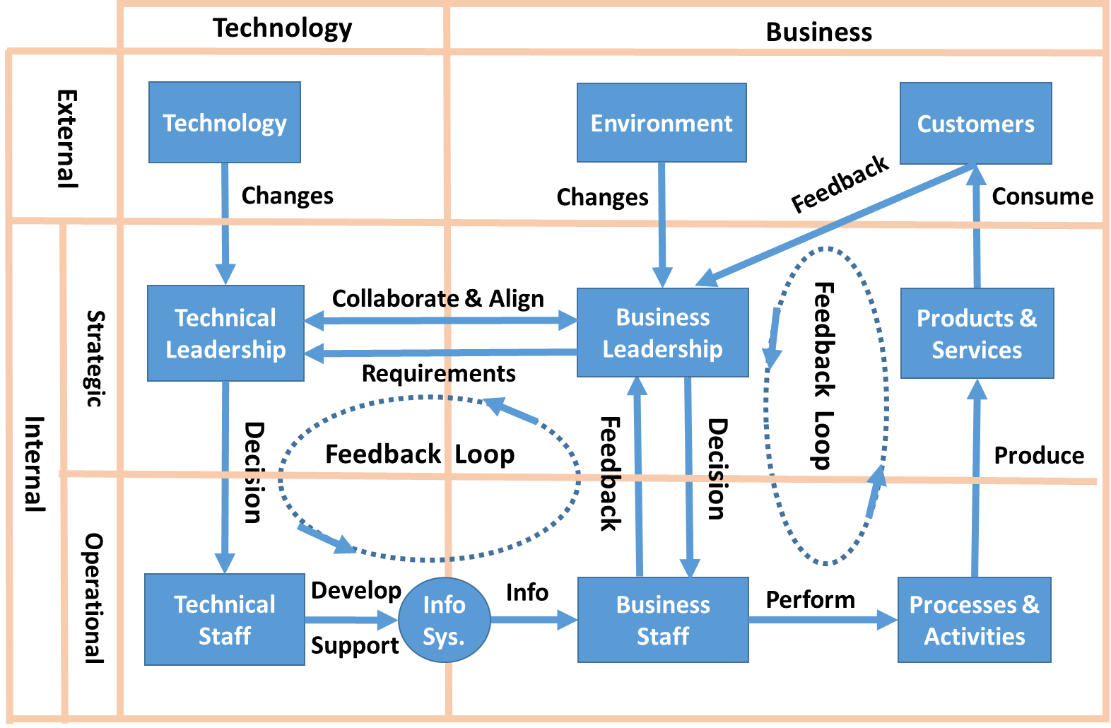
Sociotechnical System (STS)
Complex Adaptive System (CAS)
Technology-Organization-Environment (TOE)
Actor Network Theory (ANT)
Diffusion of Innovation
Work System
Method (WSM)
Organizational
Learning Theory
Agency Theory
Institutional Theory
Transaction Cost Economics
SERVQUAL
IS Success Model
Design Theory
Technology Acceptance Model (TAM)
For all IS theories, visit http://is.theorizeit.org

Slide 6

Learning Organization
"Personal mastery is a discipline of continually clarifying and deepening our personal vision, of focusing our energies, of developing patience, and of seeing reality objectively."
"Mental models are deeply ingrained assumptions, generalizations, or even pictures of images that influence how we understand the world and how we take action."
"Building shared vision - a practice of unearthing shared pictures of the future that foster genuine commitment and enrollment rather than compliance."
"Team learning starts with dialogue, the capacity of members of a team to suspend assumptions and enter into genuine thinking together."
"Systems thinking - The Fifth Discipline that integrates the other four."

